Slide 1
A diagram editor to mechanise categorical proofs
Ambroise Lafont
Birmingham, 31 May 2024
Notes:
Bonjour, je vais vous presenter mon porfil autour des langages et preuves mécanisées pour un poste de charche de recherche de classe normale au CNRS
Je suis actuellement en postdoctorat depuis 2022 a l’universite de Cambridge. Apres un premier doctorat a l’universi entre 2020 et 2022, suivant ma these
A quoi ca sert de verifier un compilateur
Precedemment, j’etais
Pas assez articule
Je parle trop vite
Variable binding and substitution for (nameless) dummies

Slide 2
Naming convention
Yet Another Diagram Editor
(not to be confused with Yet Another Dynamical Engine!)
I will refer to the editor as YADE, or Coreact-YADE
ANR Project¹ (2023 - 2027): Coq-based Rewriting: Towards Executable Applied Category Theory
¹ https://coreact.wiki/

Slide 3
Packaging
A web app that runs locally in your browser
(without mechanisation features)
A standalone desktop program
(embeds the web app using electron)
https://amblafont.github.io/graph-editor/index.html

Slide 4
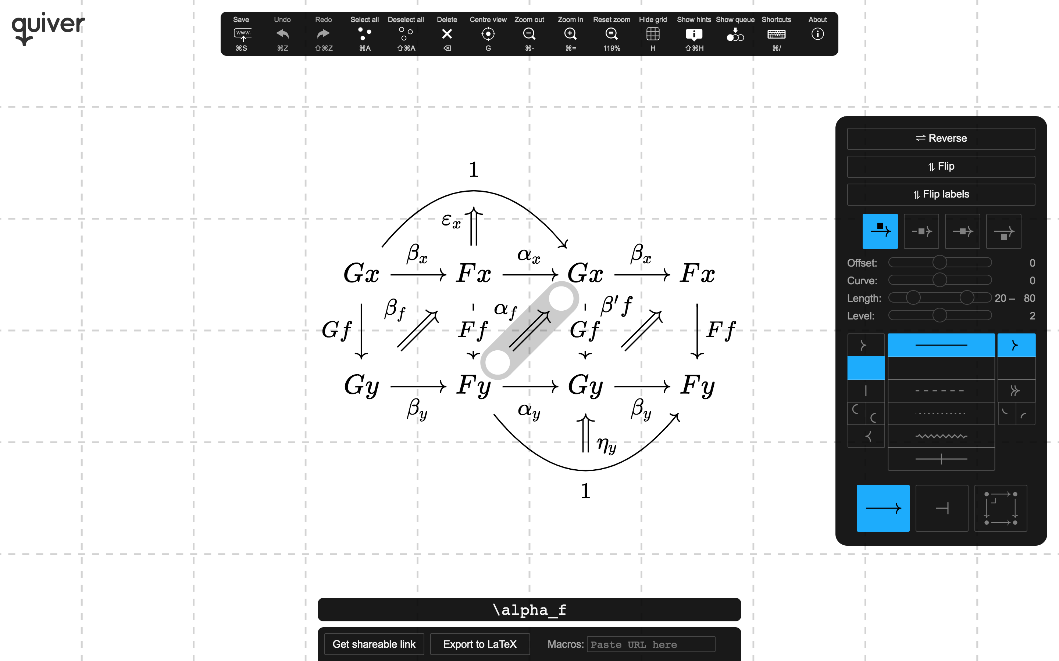
An other diagram editor: Quiver
“a modern, graphical editor for commutative and pasting diagrams, capable of rendering high-quality diagrams for screen viewing, and exporting to LaTeX via tikz-cd.”

Slide 5
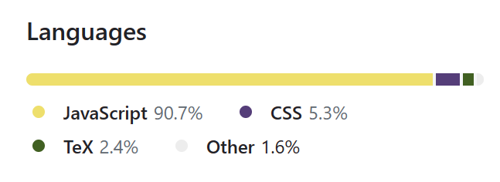
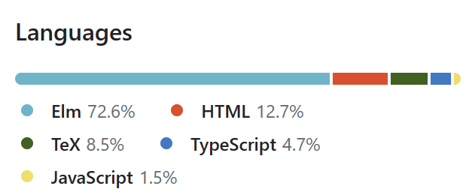
Comparison with quiver
About the same size (around 10k of LoC)
 | Quiver | YADE
Programming Languages | JavaScript + React
Styling options | + | -
User-friendly | + | -
Editing features | - | + Tabs, copy & paste, find & replace, expand selection to connected components, …
LaTeX export | Yes, and also import | yes

Slide 6
Comparison with quiver
About the same size (around 10k of LoC)
 | Quiver | YADE
Programming Languages | JavaScript + React
Styling options | + | -
User-friendly | + | -
Editing features | - | + Tabs, copy & paste, find & replace, expand selection to connected components, …
LaTeX export | Yes, and also import | yes

Slide 7
LaTeX features

Slide 8
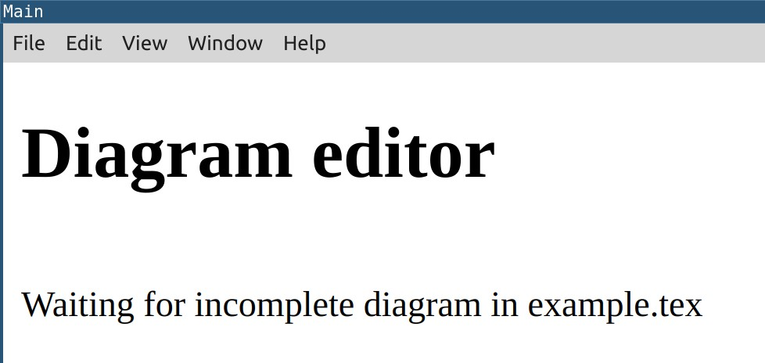
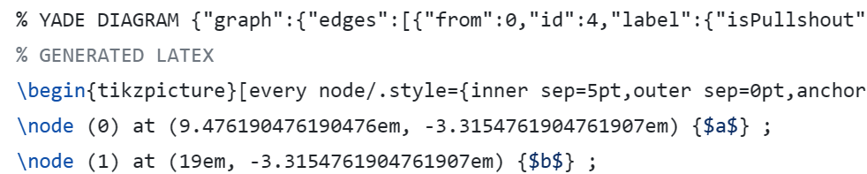
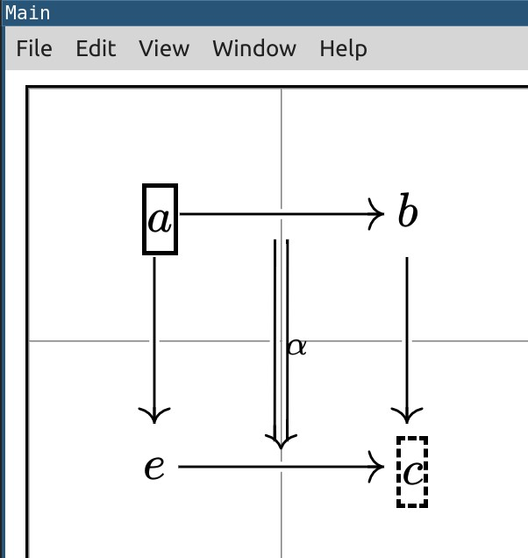
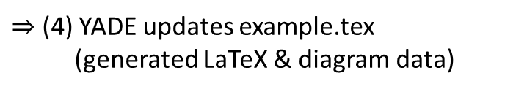
Easy editing of LaTeX diagrams
diagram data
example.tex
standalone version, running in the background
(1) Remove the generated latex
$⇒$ (2) YADE loads the diagram
(3) Edit & Save the diagram in YADE
$⇒$ (4) YADE updates example.tex
(generated LaTeX & diagram data)
DEMO

Slide 9
Comparison with quiver
About the same size (around 10k of LoC)
 | Quiver | YADE
Programming Languages | JavaScript + React
Styling options | + | -
User-friendly | + | -
Editing features | - | + Tabs, copy & paste, find & replace, expand selection to connected components, …
LaTeX export | yes | yes

Slide 10
Comparison with quiver
About the same size (around 10k of LoC)
 | Quiver | YADE
Programming Languages | JavaScript + React
Styling options | + | -
User-friendly | + | -
Editing features | - | + Tabs, copy & paste, find & replace, expand selection to connected components, …
LaTeX export | yes | yes
Mechanisation features | no | yes

Slide 11
Mechanisation features

Slide 12
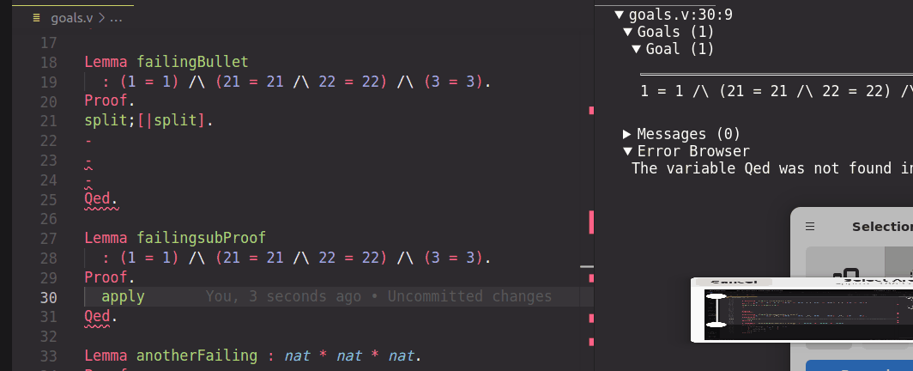


The Coq proof assistant
A software to write formal proofs interactively
File editor, e.g., Visual Studio Code + coq-lsp extension
Coq
Edited file
Feedback from Coq
There is also a web version of Coq (no installation required): https://coq.vercel.app/

Slide 13

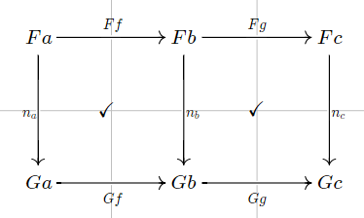
Architecture of YADE
Diagram editor
(standalone version)
Custom vscode extension
(building upon coq-lsp)
Visual Studio Code
Generate proofs
Show diagram
under cursor
Construct diagrams step by step
(+ Coq library for custom notations)

Slide 14

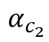
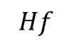
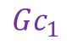
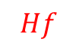
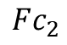
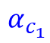
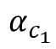
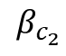
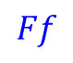
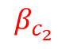
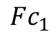
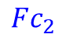
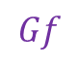
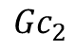
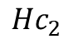
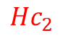
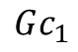
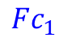
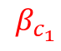
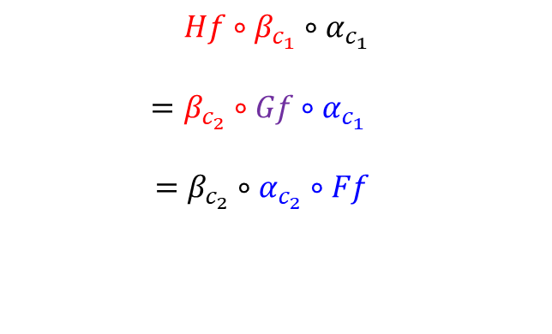
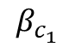
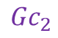
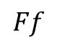
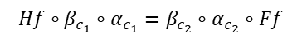
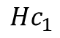
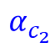
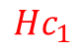
Natural transformations compose:
Automatic generation?
Diagrammatic proof
Computer-friendly proof
$$α_{c_{1}}$$
$$β_{c_{1}}$$
$$Fc_{1}$$
$$Gc_{1}$$
$$Hc_{1}$$
YADE
?
$$Ff$$
$$Hf∘β_{c_{1}}∘α_{c_{1}}=β_{c_{2}}∘α_{c_{2}}∘Ff$$
$$Hf$$
$$Hf∘β_{c_{1}}∘α_{c_{1}}$$
$$=β_{c_{2}}∘Gf∘α_{c_{1}}$$
$=β_{c_{2}}∘α_{c_{2}}∘Ff$
$$Fc_{2}$$
$${Gc}_{2}$$
$${Hc}_{2}$$
$$α_{c_{2}}$$
$$β_{c_{2}}$$
$$α_{c_{1}}$$
$$β_{c_{1}}$$
$$Fc_{1}$$
$$Gc_{1}$$
$$Hc_{1}$$
$$Ff$$
=
$$Gf$$
=
$$Hf$$
$$Fc_{2}$$
$${Gc}_{2}$$
$${Hc}_{2}$$
$$α_{c_{2}}$$
$$β_{c_{2}}$$

Slide 15
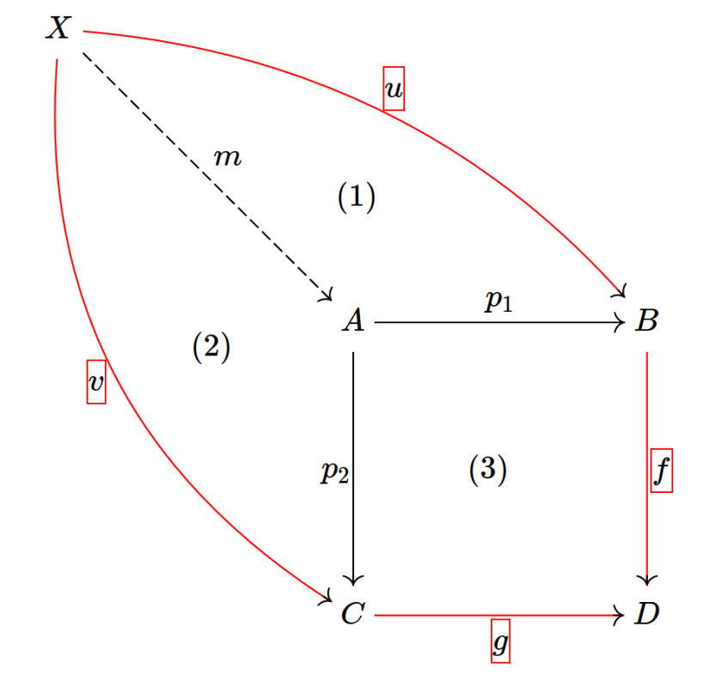
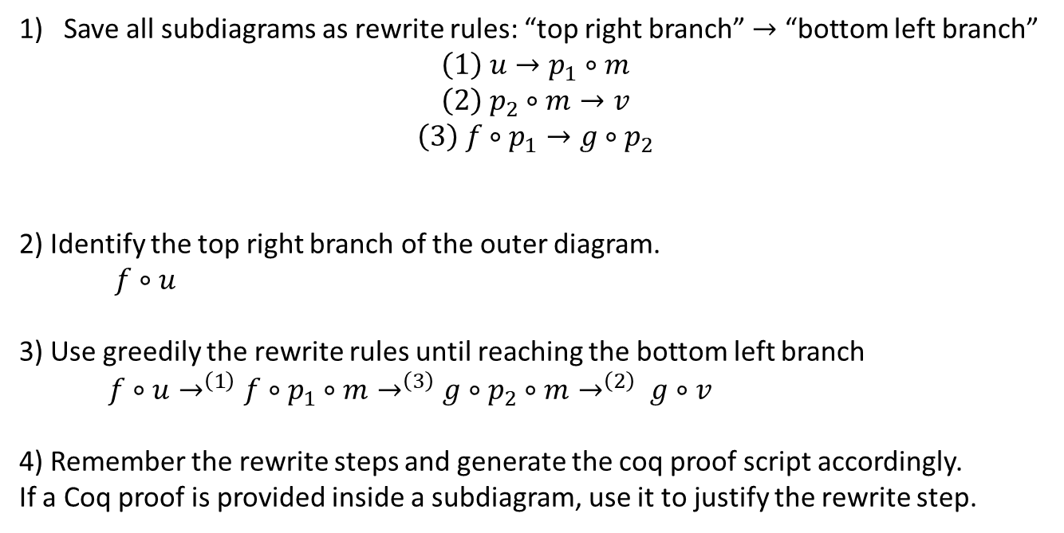
Proof generation: sketch of the algorithm
Save all subdiagrams as rewrite rules: “top right branch” $→$ “bottom left branch”
$$\left(1\right) u→p_{1}∘m$$
$$\left(2\right) p_{2}∘m→v$$
$$\left(3\right) f∘p_{1}→g∘p_{2}$$
2) Identify the top right branch of the outer diagram.
$f∘u$
3) Use greedily the rewrite rules until reaching the bottom left branch
$f∘u→^{\left(1\right)}f∘p_{1}∘m→^{\left(3\right)}g∘p_{2}∘m→^{\left(2\right)} g∘v$
4) Remember the rewrite steps and generate the coq proof script accordingly.
If a Coq proof is provided inside a subdiagram, use it to justify the rewrite step.

Slide 16
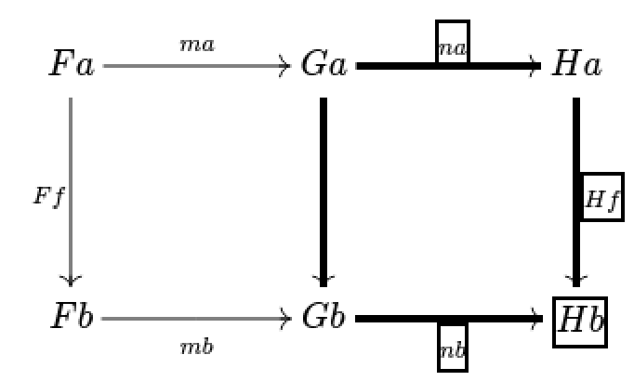
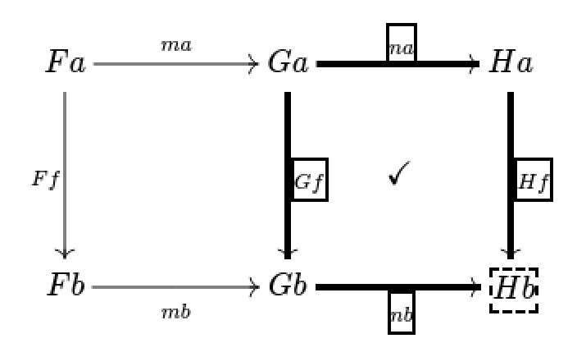

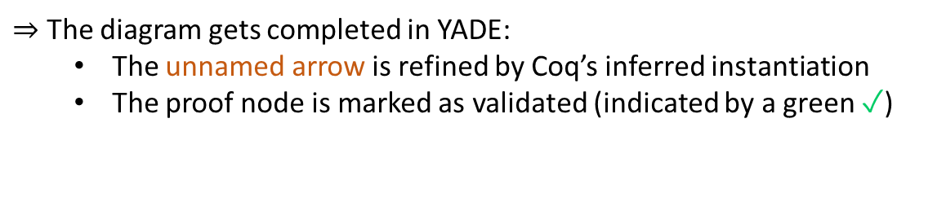
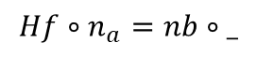
Building the diagrammatic proof interactively
1) Select a subdiagram
2) Create a proof node, labelled with the Coq tactic naturality.
unnamed arrow
$⇒$ Coq (in vscode) checks that this tactic solves the goal:
$$Hf∘n_{a}=nb∘_$$
$⇒$ The diagram gets completed in YADE:
The unnamed arrow is refined by Coq’s inferred instantiation
The proof node is marked as validated (indicated by a green ✓)
✓

Slide 17
Demo¹ of YADE
(Based on the category theory library of Hierarchy Builder + custom tactics & notations)
A distributive law $δ:TS⇒ST$ between two monads $S$ and $T$ induces a monad structure on $ST$.
Let us show that the induced multiplication $STST\overset{SδT}{→}SSTT\overset{μ^{S}μ^{T}}{→}ST$ is associative.
¹ https://github.com/amblafont/vscode-yade-example

Slide 18
Coq tactics and notations (yade.v)

Slide 19
The tactic norm_graph
$$f·g=h \text{·} k$$
Coq goal
norm_graph.
a -- f -> b -- g -> c = a -- h -> d -- k -> c
Objects are explicit in the final goal.
YADE can parse directly the output string.
norm_graph is (silently) called by the vscode extension before sending data to YADE.
You should not need to call this tactic yourself.

Slide 20
Categorical notations
Declaration of two “notation scopes”, for morphisms and objects
Declare Custom Entry obj.
Declare Custom Entry mor.
“Space” is functor application and is right associative:
“T T x” means “T (T x)”
“|x|” is the identity morphism on “x”
(norm_graph removes the delimiters ‘|’)
Useful even without YADE

Slide 21
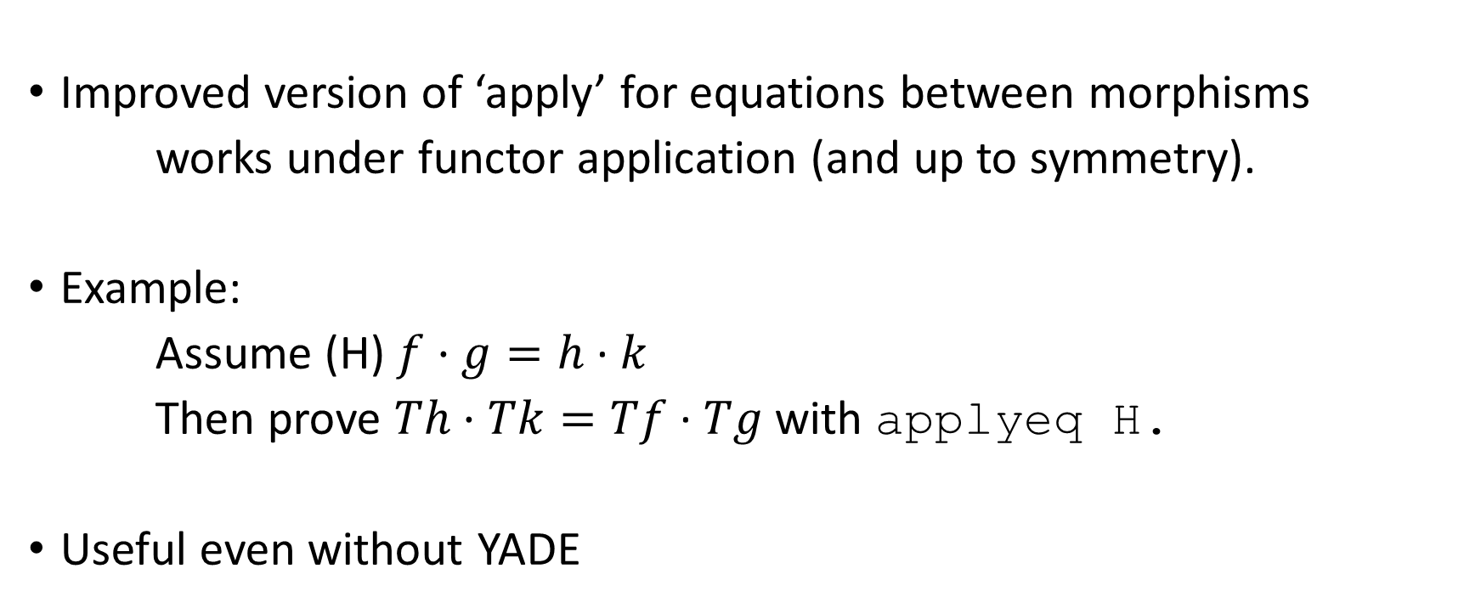
The tactic applyeq
Improved version of ‘apply’ for equations between morphisms
works under functor application (and up to symmetry).
Example:
Assume (H) $f·g=h \text{·} k$
Then prove $Th·Tk=Tf \text{·} Tg$ with applyeq H.
Useful even without YADE

Slide 22
The underlying category theory library (definition of categories, functors, …)
Originally, based on the (big) UniMath library
The demo is based on Hierarchy Builder’s (small) library
Faster installation
Part of the coreact ANR project
Adaptation was easy
just redefine some lemmas / notations on top of your favourite library
(see yade.v)

Slide 23
Installing Coreact-YADE

Slide 24
How to try Coreact-YADE
Requirements for the full example available on github¹
Package manager for ocaml softwares / libraries
opam
Coq-lsp runtime
Handles communication between vscode and Coq
Hierarchy builder
A coq library to help building algebraic hierarchies
(e.g. categories)
Coreact-yade extension
Packaged as .deb (Debian amd64)
or .img (MacOS arm64)
Coq
Visual Studio Code
Coreact-YADE
¹ https://github.com/amblafont/vscode-yade-example

Slide 25
How to make YADE easier to install?
The lazy way:
Distribute an “image” of an OS with everything installed, for some emulation software
✓ No need to change the implementation
✖ Still requires to install the emulation software
✖ Images can be big (several GBs).
The clean way:
Embed YADE in (the web version of) vscode
✓ No installation:
run vscode + coq + YADE in your browser
✖ Requires a lot of engineering.
The very lazy way:
Distribute an installation script to build the “image” on the user machine
✓ No need to host the (big) image
✖ Less robust
What I did

Slide 26
Testing YADE in an emulated environment
can run an image of a full OS (e.g., Debian) on any host operating system (Windows / Mac / Linux)
Virtual Box
Docker
✓ Better performance (probably not very relevant for YADE)
✓ A modular system to build new images
recipes are called dockerfiles
a dockerfile can extend another one
✖ Not readily cross-platform
✖ Configuration is complex (especially for GUI images)
✓ Easy to install
✖ Big image size
Installation script
Installation script
A shell script to be run in a fresh Debian image¹
A dockerfile (extending that of coq)
Check https://github.com/amblafont/vscode-yade-example for instructions!
¹https://www.linuxvmimages.com/

Slide 27
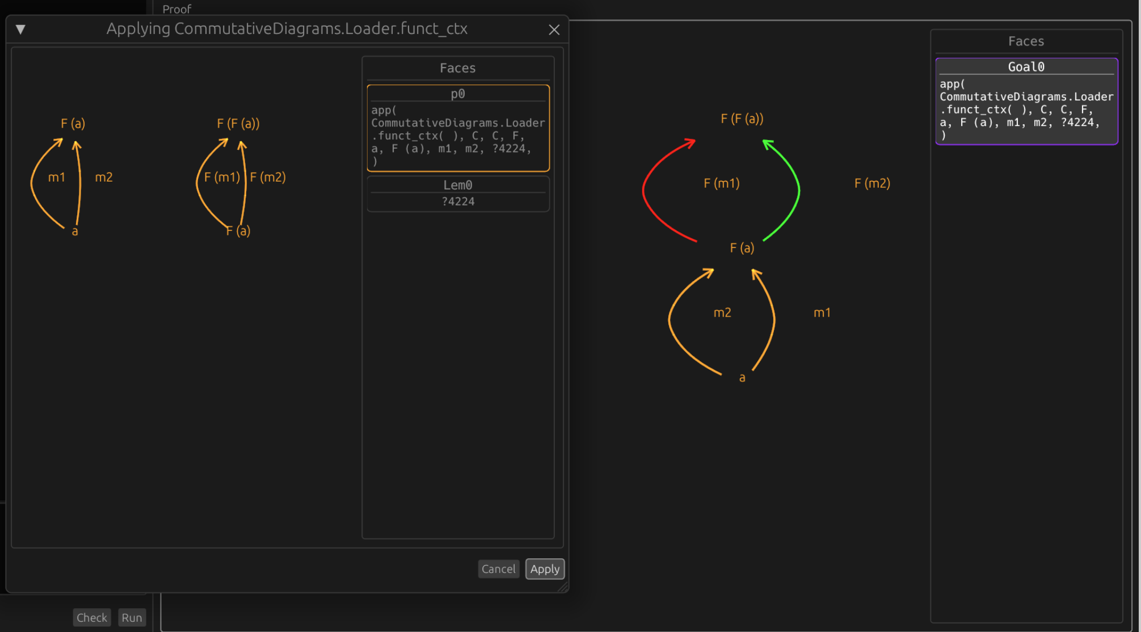
Another related software for mechanisation:
Luc Chabassier’s interface for diagrammatic proofs¹
Goal, assumptions, lemmas
Graphical interface
(standalone program,
implemented in Rust)
Coq plugin
(ocaml)
Lemma …
Proof.
…
diagram server.
Coq proof term
(implicit)
Automatic layout (limited (see yade.v): manual editing)
Proof tactics (including invoking a lemma)
Integrated search for lemmas
¹ https://github.com/dwarfmaster/commutative-diagrams

